Slide 1


Improved Performance in hBN encapsulated MoS₂ Field-Effect Transistors Contacted by Highly Doped Graphene Electrodes. Meeghage Madusanka Perera, Hsun-Jen Chuang, Bhim Prasad Chamlagain and Zhixian Zhou* (Department of Physics and Astronomy, Wayne State University)

Slide 2
Outline
Motivation
Results
Graphene contacted MoS₂ FETs encapsulated by hBN.
Using molecular doping with Benzyl Viologen (BV) to tune the contact barrier.
Four-probe measurement to understand the intrinsic channel properties and scattering mechanisms.
Conclusions
Notes:
I’m going to talk about improved performance of hBN encapsulated FETs with highly doped graphene contacts.
So this is my outline. I’ll start with the motivation, present the results and followed by the conclusions.
My results will include transport properties of gr.con.Mos2 FETs with hBN encapsulation, how B.V doping improve the contacts, and
intrinsic cannel properties of the device extracted from the 4 probe measurements.

Slide 3
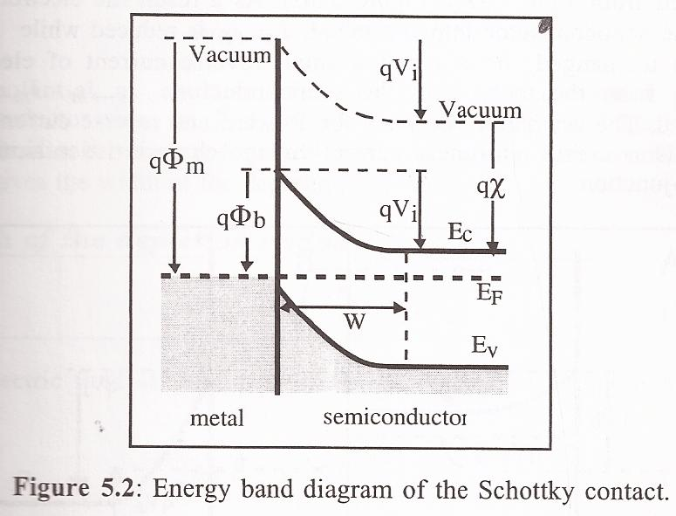
Motivation
For large band gap semiconductors such as MoS₂, a significant Schottky barrier may form at the metal/semiconductor contact, yielding a high contact resistance. To optimize the performance of MoS₂ FETs, it is crucial to use low resistance Ohmic contacts.
Our Approaches
Reducing Schottky barrier height by heavily n-doping the graphene contacts using strong electron donating Benzyl Vologen (BV)
Using hBN encapsulation to protect the channel from BV doping and preserve the intrinsic channel properties of MoS2
Notes:
Large band gap semiconductors like Mos2 forms a significant schottky barrier at metal semiconductor contact leading to a high contact resistance.
In order to optimize the performance it’s neseserrry to reduce the contat resistance.Here I have a band diagramme of such a schottky barrier forms at metal/semiconductor interface. Another factors are charge impuruities and channel defects.Due to these factors the reported mobilities are still less than the theoretical values.
To overcome these challenge we fabricate FETs encapslated with hBN from top and bottom,to minimize extrinsic scattering sources, use graphene contacts with molecular dopent BV to tune and achieve low resistance ohmic contacts.

Slide 4
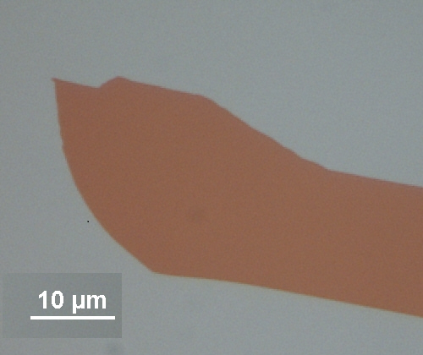
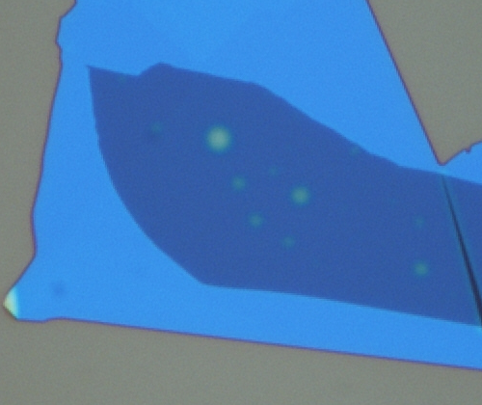
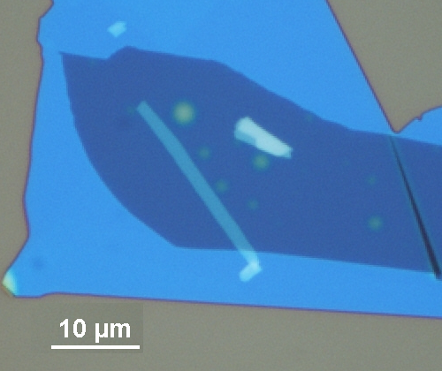
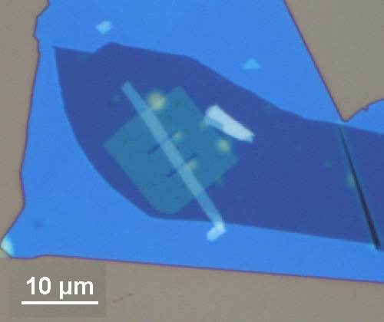
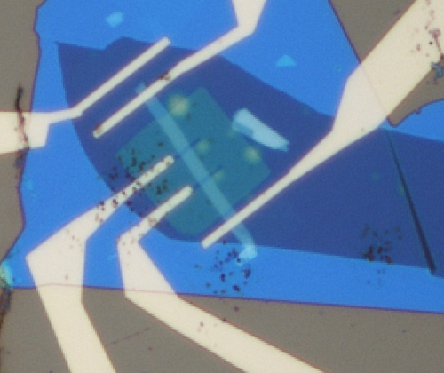
Animation for fabrication steps
CVD graphene
Patterned
hBN
hBN
MoS₂
Cross section
ILg
Au/Ti electrode
SiO₂
Si
Notes:
To minimize surface and interface scattering, hBN was used to passivate both the top and bottom surfaces of the MoS2 channel.

Slide 5
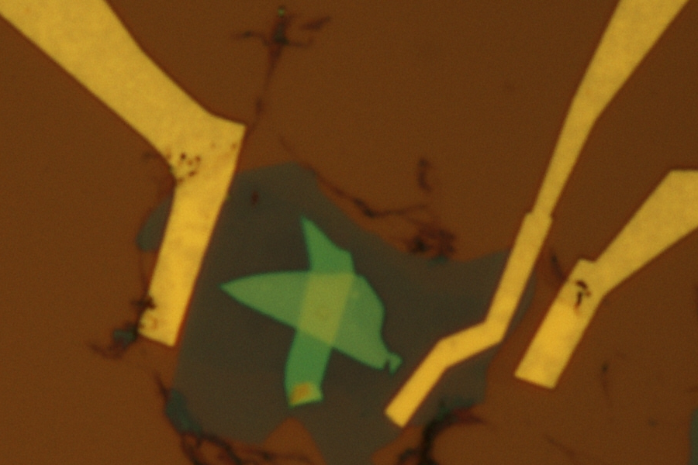
Graphene contacted MoS₂ FET with hBN encapsulated channel
passivation hBN
L:2.5 um
W: 4.1 um
d: 9 nm
Bottom hBN
MoS2
Notes:
The OM picture right here shows the graphene contacted device with hbn encapsulation after fabrication.

Slide 6
I_{ds} Vs V_{ds} of MoS₂ FET with graphene drain/source electrodes at 77K and RT
Notes:
To understand how the qaulity of contacts without doping, Ids Vs Vds curves were meassured with fixed various bg voltages at 77K and at room temperature.
At room temmperature the curves are linear indicating it already has thermally assisted tunneling current,+ overcome the barrier height.
The device at 77K shows non linear behavious at low bias region indicating the existance of schootky barrier.

Slide 7
Before and after BV doping of graphene contacts
Graphene
MoS₂
Without doping
E_{F}
E_{F}
With B.V
doping
Notes:
This schametic diagramme shows how the b.V doping make the schottky barrier height smaller by tuning the fermi level of graphene contacts.
Before doping the fermi level of graphene is at a low position while forming a significance schotky barrier height.
B.V doping tune the fermi level towards the conduction band minimum of Mos2 such that it makes lower schottky barrier height.

Slide 8
I_{ds} Vs V_{ds} at 77K before and after BV doping of graphene contacts
T=77K
T=77K
Notes:
When the graphene contacts doped with B.V, the IV chracterisics become linear even at 77 K.This indicates that we achieved low resistance ohmic contacts by tuning the graphene fermi level and making the schottky barrier height smaller.

Slide 9
I_{ds} Vs V_{bg} before and after BV doping of graphene contacts
The linear region used to calculate
the field-effect mobility
Bear
Bare
Notes:
Here we have a comparison of backgate dependency curves of the same device with and without B.V doping.The undoped device shows metal to insulator transition behavior below 180K.The device after doping shows metalic behavior for entire temperature range.
The maximum current at 77K improves approximately by factor of 10.The dash line over here in this curve shows the linear region we used to calculate the mobility.

Slide 10
2-probe mobility before and after BV doping of graphene contacts
2 probe
Bare
Notes:
Here we have the temperature dependence of the low-field field-effectt mobility.
For the bare device mobility values are small specially at the low temperature range.
As we can see the mobility slightly increases with temperature in the temperature range from 77K to 140K due to the thermelly activation energy and carriers overcome the schootky barrier.
When contacts doped with b.V the mobility increses dramatically specially at low temperatures.At 77 k the mobility was increased more than 5 orders of magnitude. For the entire temperature range the mobility decreases as increasing temperature, indicating that the mobility is mainly limited by phonons.

Slide 11
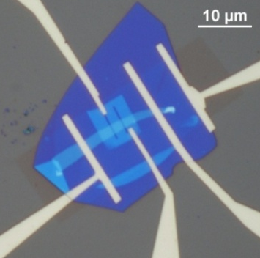
Four probe MoS2 FET ,to understand the intrinsic transport properties and scattering mechanisms
Inner electrode separation (L): 2.4 um
Channel Width(W): 2.5 um
Channel length(length of hBN)= 7.32 um
d= 4.9 nm
Notes:
From here onwards I’ll be presenting 4 probe MoS2 FET results which will help us to understand the intrinsic transport limit.
Intrinsic channel properties and scattering mechanisms
hBN encapsulation of the channel
4-probe measurement to exclude the contact effects

Slide 12
4-probe conductivity vs. gate-voltage of graphene contacted MoS₂
Bare
Notes:
4-probe dondutivity for bear at different Temp

Slide 13
4 –probe mobility of h-BN encapsulated MoS₂ independent of graphene contact doping
Bare
Notes:
The phonon limited mobility decreases with increasing temperature following a power law dependence, similar to MoS2 devices fabricated on SiO2 and Al2O3 substrates as reported in the literature. However, the gamma is much large than on oxide substrate, but it is consistent with a recently work on h-BN encapsualted MoS2. The large gamma indicates reduced interface and substrate scatterings due to charged impurities.
Further improving the contacts such as using ionic liquid gating does not affect the intrinsics channel mobility of hBN encapusulated devices measured in a 4-probe configuration.

Slide 14
Conclusions
Used molecular doping on graphene to reduce the Schottky barrier height at graphene/MoS2 contacts
Highly doped graphene contacts lead to improve MoS2 device performance
Nearly intrinsic electrical transport has seen in hBN encapsulated MoS2, which is independent of contact doping.

